Slide 1
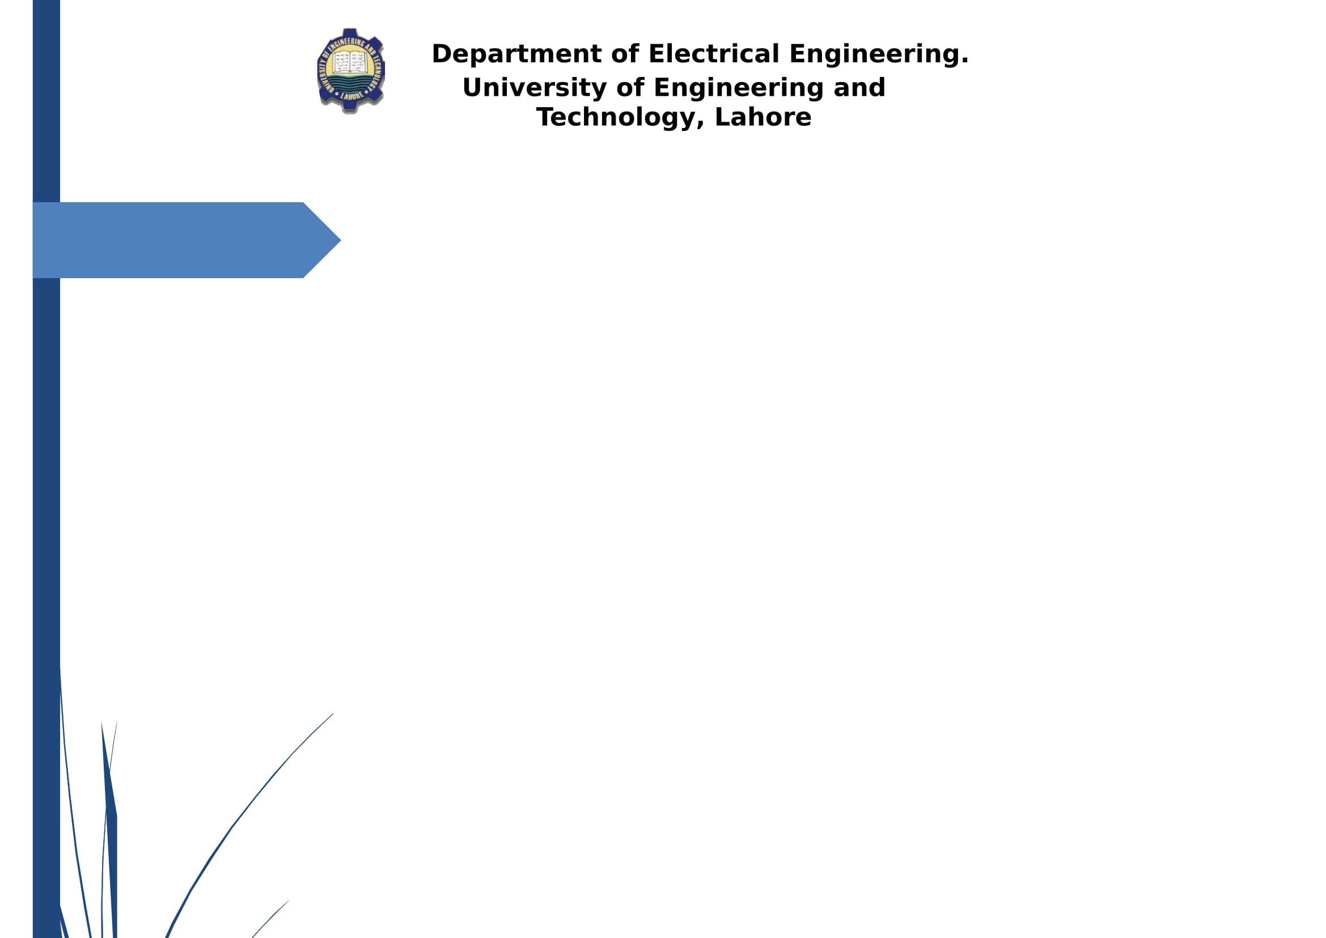


GeneBird Design & Development of Micro Swarm Drones
GeneBird
Project Advisor: Dr. Muhammad Kamran
Co-supervisor: Mr. Fahad Ijaz
Department of Electrical Engineering,
University of Engineering and Technology, Lahore (New Campus)
Undergraduate Final Year Project Presentation
Dated: 7th January, 2021

Slide 2
Team Introduction
Khalid Waheed
2017-EE-281
Specialization:
Major: Computer, Minor: Power
Noor ul Haq
2017-EE-298
Specialization:
Major: Computer, Minor: Power
Salman Hamid
2017-EE-325
Specialization:
Major: Computer, Minor: Power
Fahad Mehmood
2017-EE-330
Specialization:
Major: Power, Minor: Computer
Undergraduate Final Year Project Presentation
Dated: 7th January, 2021

Slide 3
Idea Behind
Conducting research on the drone technology is complex and way too expensive.
The study of feedback control systems and the application of various machine learning algorithms and image recognitions algorithms, is often considered to be tough to be understood from the student’s perspective without any practical demonstration.
Patient is in severe need of blood or an organ, but due to the non-timely delivery, the patient dies.
Undergraduate Final Year Project Presentation
Dated: 7th January, 2021

Slide 4
Idea Behind
Heavy traffic results in a late delivery.
In times of crisis Rescue teams need to face huge calamities.
The inspection of radioactive or hazardous areas is life threatening for humans.
Security – Patrolling huge infrastructures requires a lot of budget.
National Security – Modern Warfare
Undergraduate Final Year Project Presentation
Dated: 7th January, 2021

Slide 5
Problem Statement
Minimizing the cost of multiple drones which have the ability to control through an edge server is a quite complex task.
Implementation of on board stability for drone flight.
Short Range of control wifi-signals.
Difficulty of updating software on soldered flight controller without FTDI board.
Less computational power for on board implementation of ML based algorithms.
Undergraduate Final Year Project Presentation
Dated: 7th January, 2021

Slide 6
Proposed Solution
The implementation of swarm algorithm to control multiple drones simultaneously.
Implementation of PID algorithm for on board stability of drones.
Increasing the connectivity range using Ad-hoc configurations (Painless Mesh Network)
OTA support for remote software updates.
Use of dual core ESP32 microcontroller for implementing ML based algorithms and live video streaming.
Undergraduate Final Year Project Presentation
Dated: 7th January, 2021

Slide 7
Key Contributions
Open Source
On board Stability
Custom designed Flight controller
Dual-core Processing
On board OTA support
Implementation of Swarm Algorithm
Implementation of Ad-hoc Network to extend coverage range.
Undergraduate Final Year Project Presentation
Dated: 7th January, 2021

Slide 8
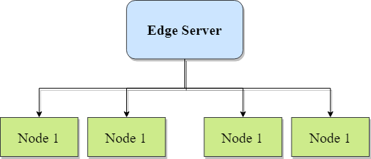
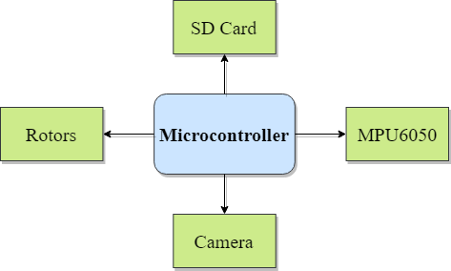
Block Diagram

Slide 9
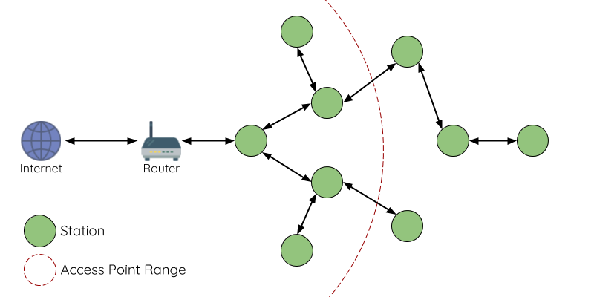

Block Diagram (Painless Mesh Network)
Mesh Node
Access Point Range

Slide 10
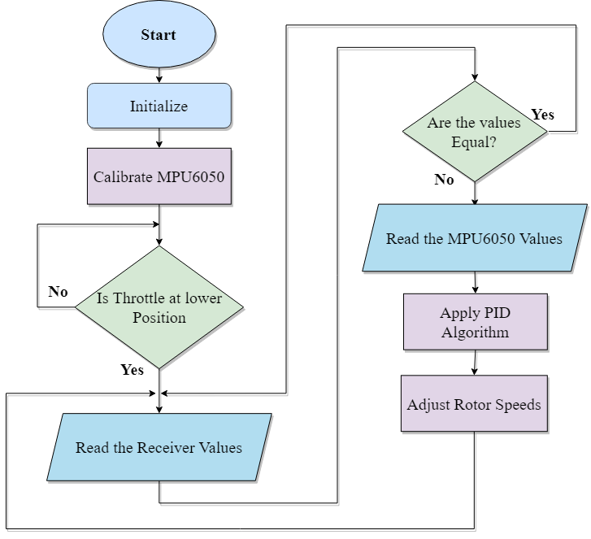
Flow Diagram (Drone)

Slide 11
Applications
GeneBird will provide a cost effective frame work for the testing and upscaling of the products developed by the companies as well as the research institutes.
GeneBird based architectures will be open source and freely accessible for everyone to conduct research on it.
Undergraduate Final Year Project Presentation
Dated: 7th January, 2021

Slide 12
Applications
Genebird based solutions can be used for STEM education by providing inspiring and captivating practical demonstrations of the different machine learning algorithms, computer vision and different control system’s concepts.
Genebird based architectures can be used as Mapping drones for mapping radioactive or hazardous areas that are not easily accessible.

Slide 13
Applications
Frameworks based on GeneBird can play a vital role in rescue operations and crisis management operations. Humans are not going to be the first responders anymore.
GeneBird based frameworks can also play a vital role in surveillance and security of large infrastructures and modern warfare i.e. IOBT applications.

Slide 14
Applications
The delay in the delivery of the packages can be reduced by building a system based on GeneBird. The use of GeneBird will not only increases the efficiency but also the productivity of the company, creating less pollution.
Genebird based architectures can be used as Agricultural drones that will increase crop production, and monitor crop growth. They can also be used for planting seeds, and spraying pesticides.
Undergraduate Final Year Project Presentation
Dated: : 4th January, 2021

Slide 15
Audience
Educational and research institutions, as well as industries and hobbyists who want to test their upcoming products on the more cost-effective architecture thus developed.
GeneBird is to play a vital role in universities; introducing students to the various concepts of machine learning and control systems as well as in colleges introducing the students to STEM education.
Undergraduate Final Year Project Presentation
Dated: 7th January, 2021

Slide 16
What we have done so far?
Designed and Developed Flight controller on TIVA, Arduino/Atmega and ESP based Architectures.
Implementation of PID algorithm for onboard stabilization of drone.
Implemented OTA support on ESP8266 based micro drone.
Undergraduate Final Year Project Presentation
Dated: 7th January, 2021

Slide 17
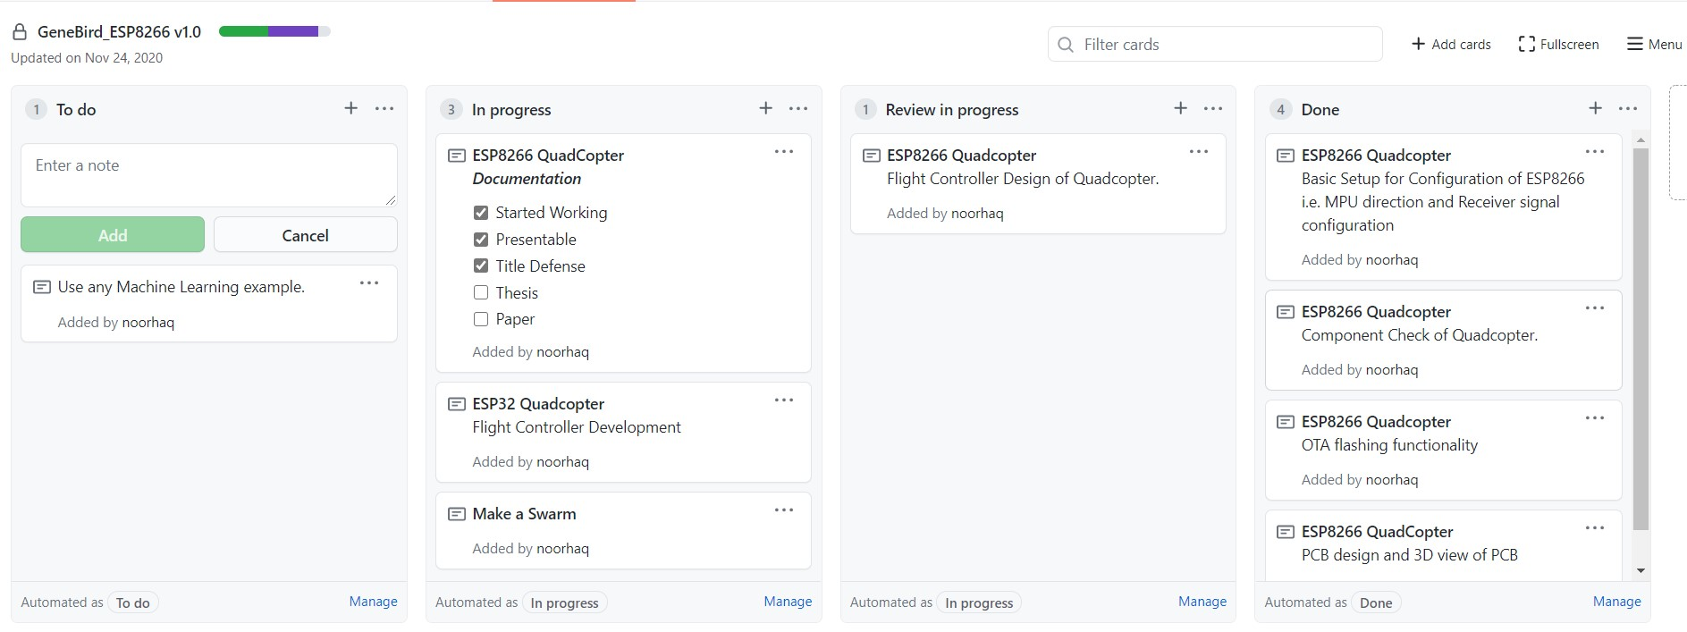
What we have done so far?
Made Github Repository for code updates and commits.

Slide 18
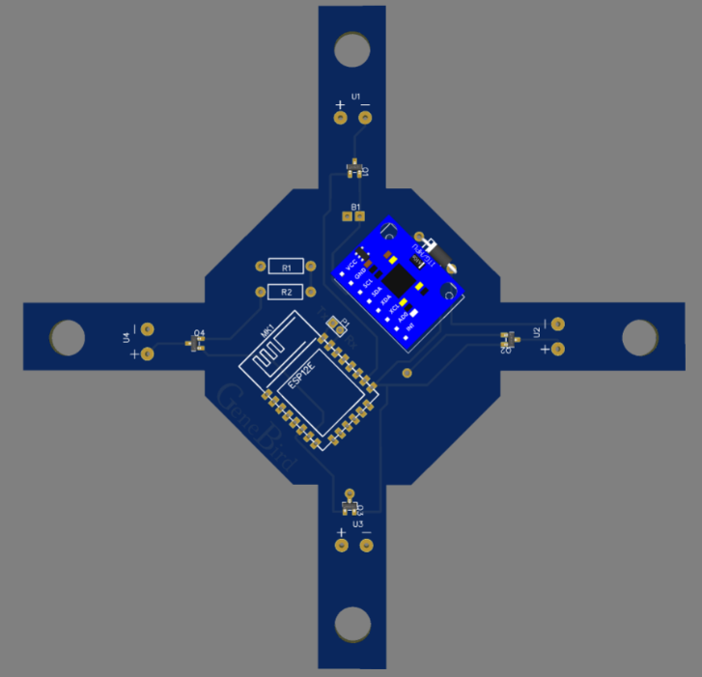
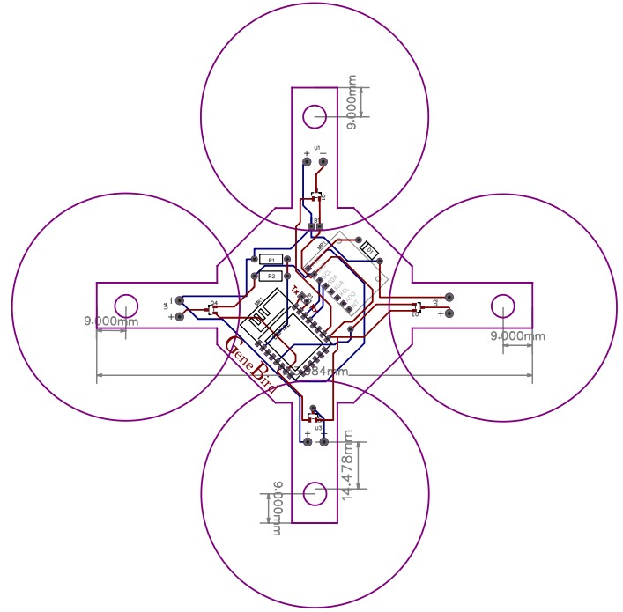
What we have done so far?
Designed PCB and Flight controller for ESP8266 based micro drone.
3D Model
Circuit Design

Slide 19
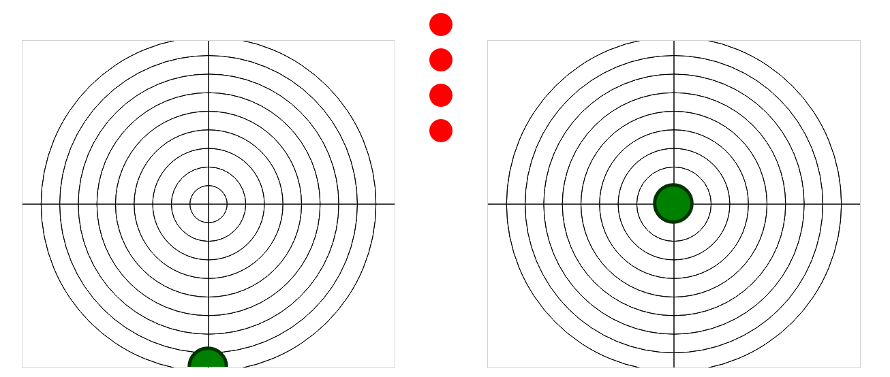
What we have done so far?
Designed HTML web page to control ESP based micro drone via IP.
Control Buttons
Throttle
Pitch
Yaw
Roll

Slide 20
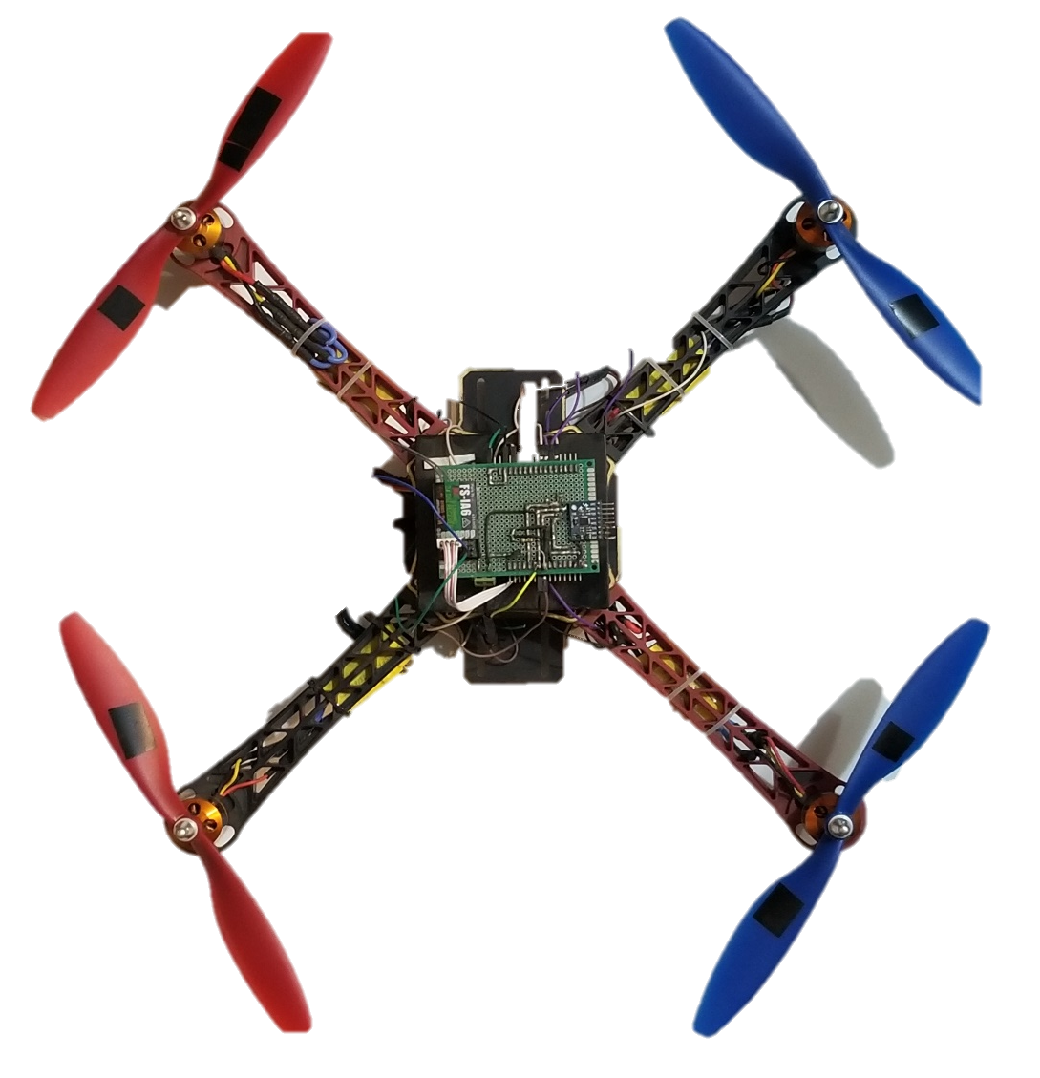
Hardware Developed
Developed drone based on TIVA and Arduino/Atmega Architecture.

Slide 21
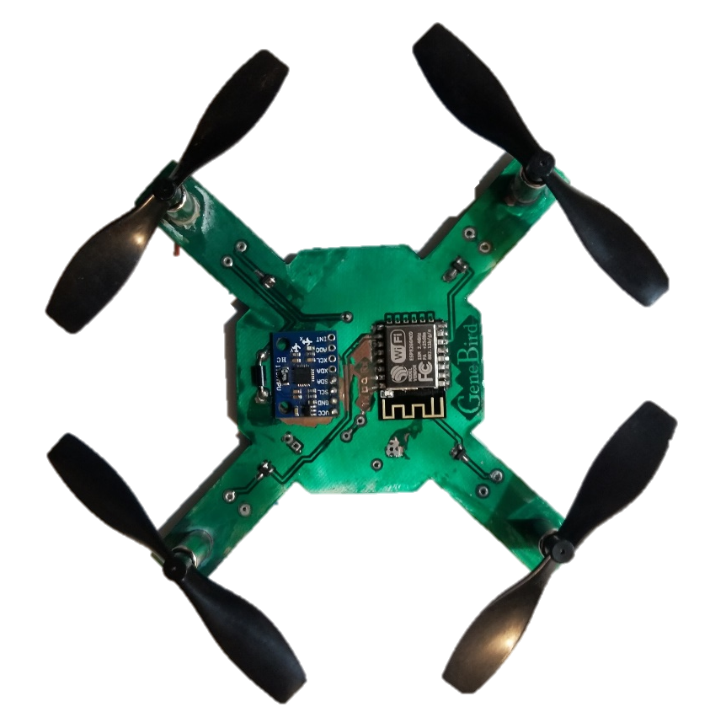
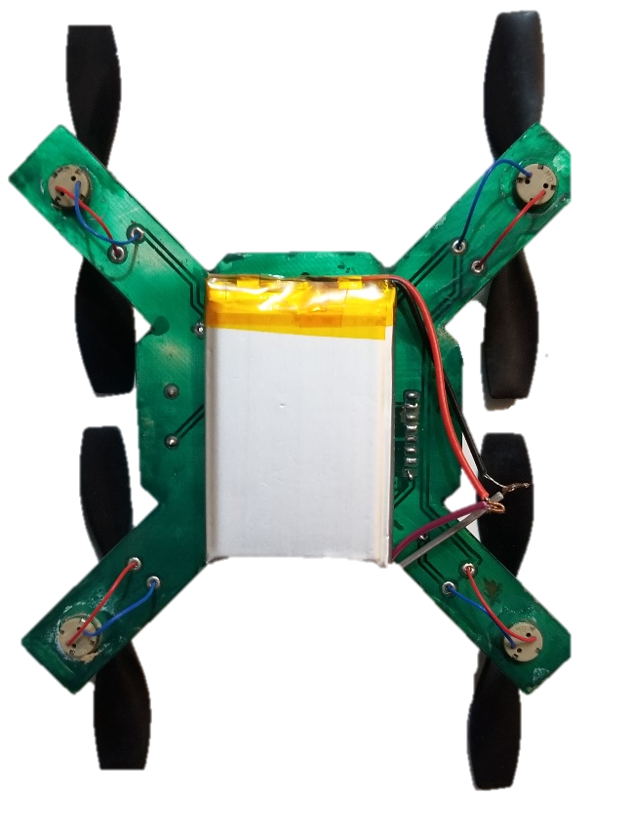
Hardware Developed
Developed ESP8266 Architecture based micro drone.

Slide 22
Future Deliverables
A swarm of 4 drones, centrally controlled from an edge server, which would have the capability of projecting live video stream from the on-board mounted camera of the controller to the server.
Undergraduate Final Year Project Presentation
Dated: 7th January, 2021

Slide 23
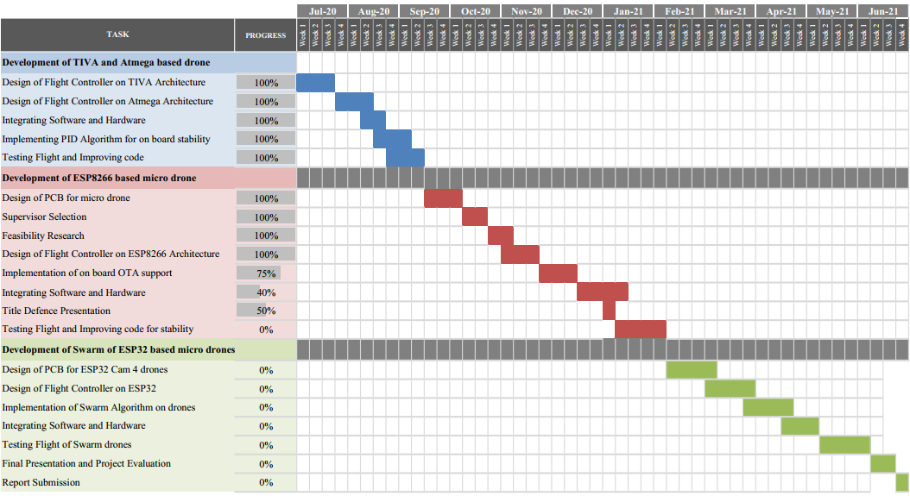
Gantt Chart

Slide 24


